Slide 1
Centroid Localization - Assumptions
Perfect Spherical Radio Propagation
Identical Tx range for all radios
The neighbouring signal points can be sync so that they do not overlap in time

Slide 2
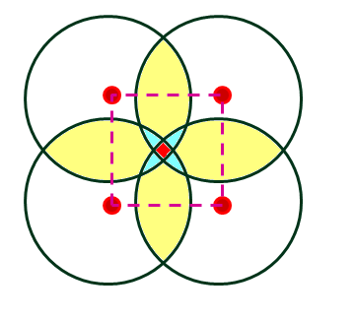

Slide 3
Position Estimation
S (x,y) = 1/n Σ_{n} B(x_{i},y_{i})

Slide 5
Weighted Centroid

Slide 6
Position Estimation
S (x,y) = [1/Σ_{n}w_{i}]*Σ_{n} w_{i} B(x_{i},y_{i})

